Slide 1
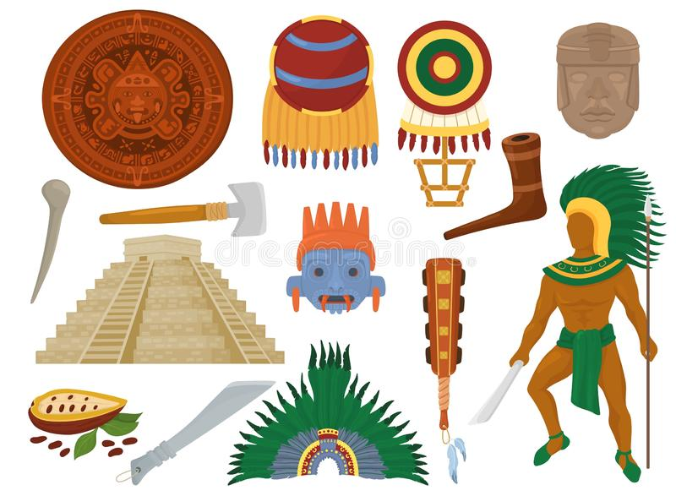
UNIT 1
The ancient Mayans
LESSON 2

Slide 4
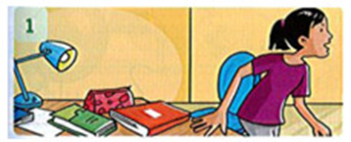
Read and circle.
 | Ly finished/ didn't finish her homework last night |  | The children hated / didn't hate the cake.
 | Dad started/ didn’t start reading a book yesterday |  | He loved / didn't love the dinner.

Slide 5
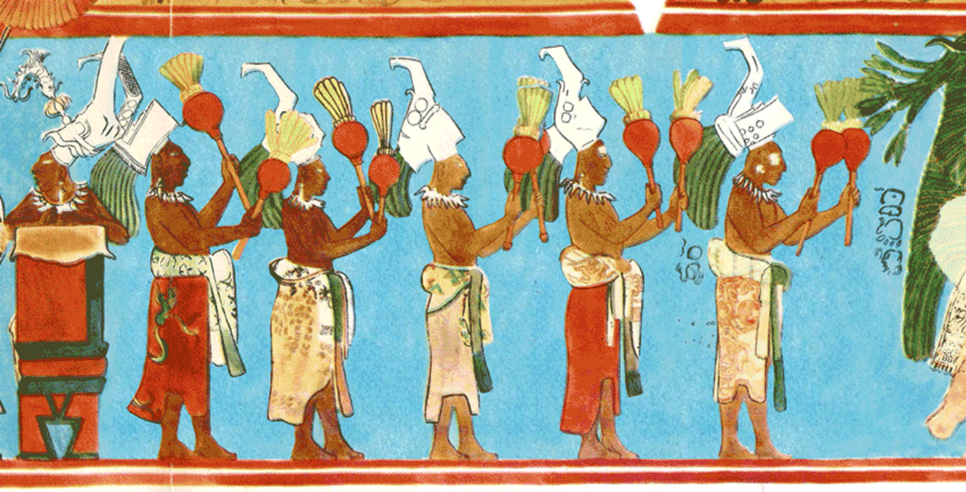
GAMETIME

Slide 6
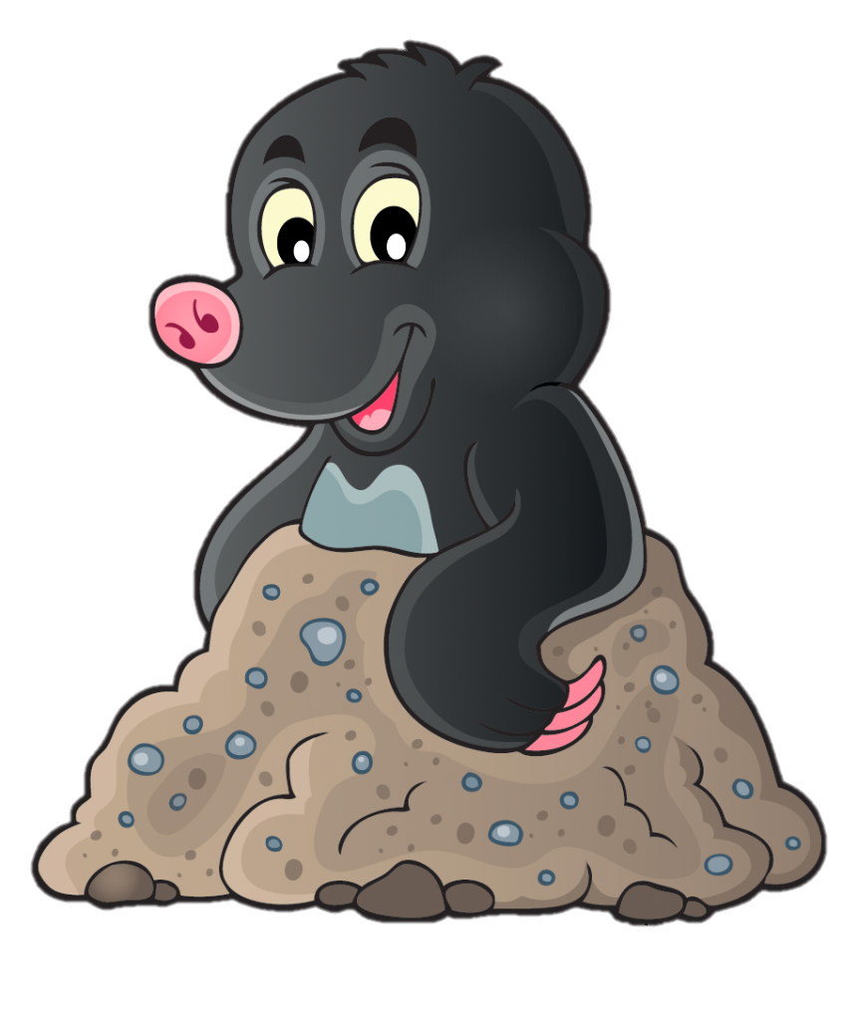
MOLE HUNT
START

Slide 7
Did the Mayans ______ in a house?
live
lived
live
life

Slide 8
didn’t cook
The Mayan women ____________ in the kitchen.
didn’t cook
cook
cooked

Slide 9
The children ________ reading yesterday.
started
start
didn’t started
started

Slide 10
The Mayans _____________ 2,000 years ago.
lived
lived
live
didn’t live

Slide 11
The Mayans ___________ pictures.
used
use
used
didn’t use

Slide 12
I didn’t ________ games yesterday.
play
played
plays
play

Slide 13
The Mayans ___________ soup.
cooked
cooked
cook
didn’t cook

Slide 15
PERFORMANCE TIME

Slide 16
Listen and repeat.

Slide 17
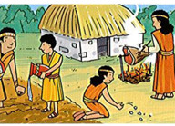
Write the answer.
1. Did the people in the picture live in a house? Yes, they did.
2. Did the woman cook in the kitchen?____________
3. Did the man work in the fields? ______________
4. Did the children watch TV?________________
5. Did the boy help his dad?______________
6. Did the girl play computer games?__________
No, she didn’t.
Yes, he did.
No, they didn’t.
Yes, he did.
No, she didn’t.

Slide 18
WORK IN PAIRS

Slide 19
WORKBOOK TIME

Slide 20
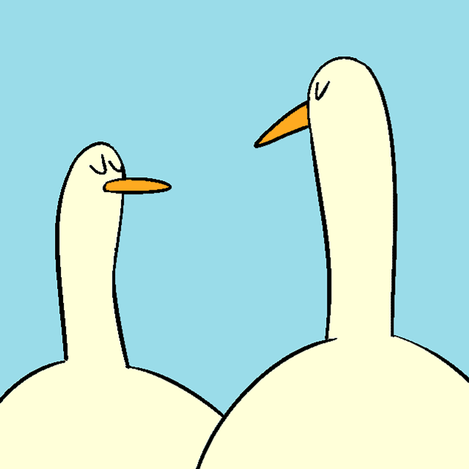
GOODBYE!!!

